Slide 1

ENGINEERING PROJECT | PROTOTYPE IN DEVELOPMENT
Marg Setu
Disaster Response & Route Coordination Platform
“Connecting incident awareness, route information, and emergency resources in one unified operational dashboard.”
A web-based disaster-management prototype that helps response teams organise incident information, review geographic conditions and make better-informed coordination decisions — with an initial focus on the challenging terrain of Sikkim and Northeast India.
Mangan · North Sikkim (illustrative terrain)

Slide 2
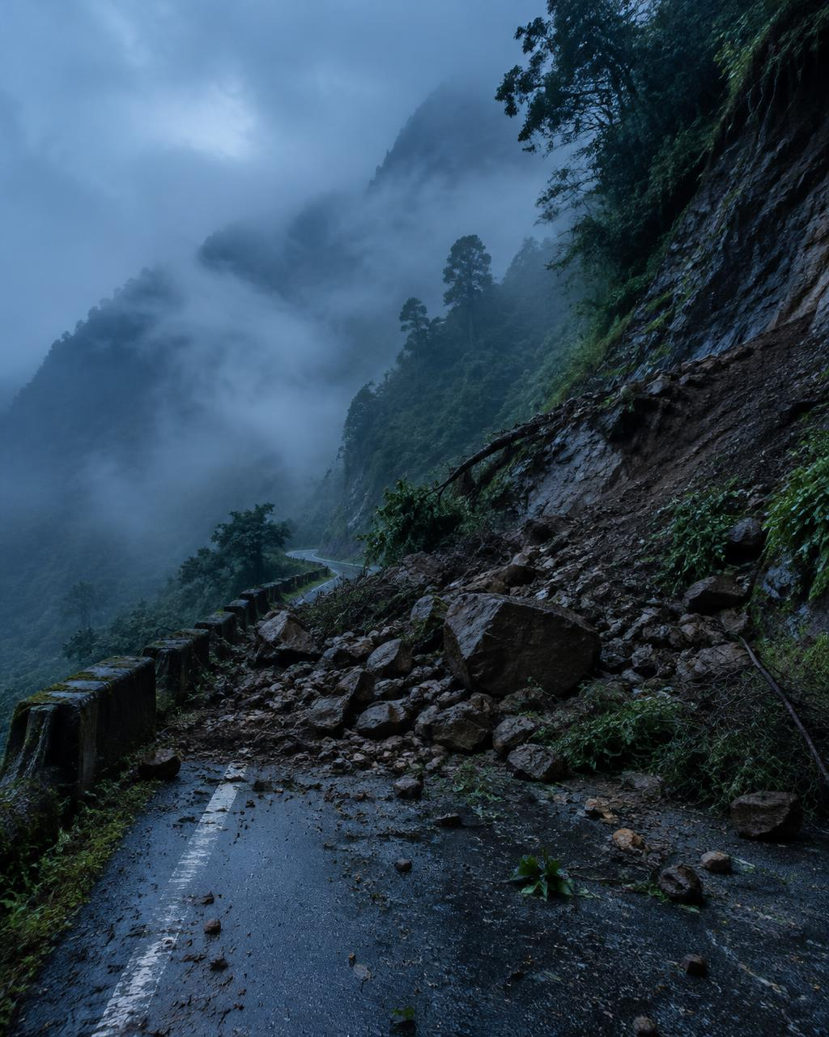
THE PROBLEM
Every decision depends on information
01
Fragmented Situational Awareness
02
Uncertain Road Accessibility
Incident reports, maps and resource details sit in separate channels, making a shared picture hard to form.
Landslides and flooding disrupt critical routes; teams struggle to assess access without current, verified information.
03
Resource Coordination Challenges
04
Delayed Field Information
When several incidents happen at once, it is hard to see where vehicles, supplies and help are needed.
Observations from disaster sites must reach coordinators in a structured, timely way to support decisions.
Landslides, flash floods and severe weather in mountain regions can cut roads and split information across many channels.
Disaster response requires more than information collection — it requires a clear, coordinated operational picture.
Illustrative image
MARG SETU | 2 / 7

Slide 3
OUR SOLUTION
One dashboard, a clearer picture
Interactive Map
MARG SETU Operations Dashboard · Illustrative data
Vehicle & Resource Overview
Geographic context for locations and reported incidents.
Incidents
Structured view of response vehicles and related details.
Incident Monitoring
Supply-Risk Awareness
Incident information organised in a dedicated panel.
Vehicles & Resources
Organises information on potential supply concerns.
Recommendation Panel
© OpenStreetMap contributors
Secure Access
Recommendations
Supply Risk
A space to present operational recommendations from available data.
Login and user-profile workflow via Firebase.
“By bringing geographic context, incident information and response-resource visibility into one interface, Marg Setu aims to reduce information fragmentation and support more informed human decision-making.”
Prototype today: dashboard UI panels, OpenStreetMap view, Firebase login.
Planned: verified live data feeds, field reporting.
MARG SETU | 3 / 7

Slide 4
HOW IT WORKS
From observation to coordination
1
Access
2
Observe
3
Assess
4
Coordinate
Authorised users sign in to the web application.
Review the map and available incident information.
Examine vehicles, recommendations and supply-risk indicators.
Teams use the information to plan appropriate next actions.
PROTOTYPE INFORMATION FLOW
OpenStreetMap data →
Interactive Map
Field Officers / Coordinators
Web Interface
React Dashboard
Incident Information
Human Review & Coordination
Resource & Decision Panels
Firebase Auth
Intended flow of the prototype. External emergency feeds, live GPS tracking, automatic dispatch and AI route-safety verification are not implemented.
MARG SETU | 4 / 7

Slide 5
TECHNOLOGY & FEASIBILITY
Built on a proven, open web stack
FRONTEND
What makes Marg Setu valuable?
React Reusable, modular UI components
Unified Operational View
Vite Dev server and production builds
Brings several categories of disaster-response information into a common interface.
JS / JSX + CSS Application logic, layout, styling
AUTH & BACKEND
Modular & Extendable
Firebase Authentication and backend integration
Dashboard components form a base for verified incident feeds, field reporting and richer resource management.
GEOSPATIAL
OpenStreetMap Map context and visualisation
Regional Relevance
DEVELOPMENT
A focus on mountain regions like Sikkim stresses geographic awareness, road access and field-to-control-room communication.
GitHub + Codespaces Source control, cloud development
No proprietary AI, predictive analytics, satellite intelligence or real-time route optimisation is claimed.
MARG SETU | 5 / 7

Slide 6
IMPACT & ROADMAP
Where Marg Setu is today — and where it can go
POTENTIAL IMPACT
Current Prototype
Integration & Validation
Future Expansion
Better visibility into reported incidents and affected areas
BUILT
PROPOSED
PROPOSED
Map, incident, vehicle, recommendation and supply-risk panels
Firebase login and user profile
Verified incident and road-condition data
Field-officer reports with photos
Testing, security, deployment readiness
Wider resource and supply tracking
English, Hindi and a Sikkim regional language
Mobile use under weak connectivity
Relevant operational information in one shared dashboard
Better-informed assessment of routes, vehicles and resources
Current limitations Marg Setu is a prototype. Recommendation reliability depends on available data and implemented logic; live emergency feeds and route-safety verification need further integration and validation.
A base for structured field reporting and relief coordination
Marg Setu aims to turn scattered operational information into a clearer foundation for coordinated disaster response.
MARG SETU | 6 / 7

Slide 7
RESEARCH & REFERENCES
Technical foundations and institutional context
1
OpenStreetMap Contributors — OpenStreetMap
2
React Documentation
openstreetmap.org/copyright
react.dev
Map data and attribution requirements for the mapping layer.
Component-based frontend development.
3
Vite Documentation
4
Firebase Documentation
vite.dev/guide
firebase.google.com/docs
Development server and production build workflow.
Authentication and backend integration.
5
National Disaster Management Authority (India)
6
National Disaster Management Plan (NDMA, India)
ndma.gov.in
ndma.gov.in
Official Indian disaster-management guidance and institutional context.
Background on coordinated preparedness and response. [Confirm edition & year before citing]
Methodology The project design combines disaster-management context with a modular web-dashboard implementation. The cited sources establish technical foundations and institutional context; they do not independently validate Marg Setu's effectiveness.
PROJECT REPOSITORY
github.com/Alliedbeast/MargSetu
MARG SETU | 7 / 7

